Slide 1
CS2100 Tutorial 7
Song Kai
song.kai@nus.edu.sg

Slide 2
1. Introduction
Two classes of logic circuits
Combinational
Sequential
Combinational Circuit
Each output depends entirely on the immediate (present) inputs.
Sequential Circuit
Each output depends on both present inputs and state.
Combinational
Logic
Combinational
Logic
inputs
: :
: :
outputs
inputs
: :
: :
outputs
Memory

Slide 3
4. Gate-Level (SSI) Design: Half Adder (1/2)
Design procedure:
1. State problem Example: Build a Half Adder.
2. Determine and label the inputs and outputs of circuit. Example: Two inputs and two outputs labelled, as shown below.
Σ
X | Y | C | S
0 | 0 | 0 | 0
0 | 1 | 0 | 1
1 | 0 | 0 | 1
1 | 1 | 1 | 0
X
Y
Half
Adder
S
C
(X + Y)
3. Draw the truth table.
Notes:
SSI Small Scale Integration
As opposed to medium scale integration

Slide 4
4. Gate-Level (SSI) Design: Half Adder (2/2)
4. Obtain simplified Boolean functions. Example: C = X∙Y S = X'∙Y + X∙Y' = X⊕Y
X | Y | C | S
0 | 0 | 0 | 0
0 | 1 | 0 | 1
1 | 0 | 0 | 1
1 | 1 | 1 | 0
5. Draw the logic diagram.
Half Adder
Block diagram of Half Adder
X
Y
S
X
Y
Σ
S
C
Half
Adder
C
(X + Y)

Slide 5
5. Block-Level Design
More complex circuits can also be built using block-level method.
In general, block-level design method (as opposed to gate-level design) relies on algorithms or formulae of the circuit, which are obtained by decomposing the main problem to sub-problems recursively (until small enough to be directly solved by blocks of circuits).
Simple examples using 4-bit parallel adder as building blocks:
1. BCD-to-Excess-3 Code Converter
2. 16-bit Parallel Adder
3. Adder cum Subtractor

Slide 6
5. 4-bit Parallel Adder (1/4)
Consider a circuit to add two 4-bit numbers together and a carry-in, to produce a 5-bit result.
X₄
X₃
X₂
X₁
Y₄
Y₃
Y₂
Y₁
4-bit
Parallel Adder
C₅
C₁
Black-box view of 4-bit parallel adder
S₄
S₃
S₂
S₁
5-bit result is sufficient because the largest result is: 1111₂ + 1111₂ + 1₂ = 11111₂

Slide 7
5. BCD to Excess-3 Converter: Revisit (2/2)
Block-level circuit:
unused
X₄
X₃
X₂
X₁
Cout
BCD
code
A BCD to Excess-3 Code Converter
S₄
S₃
S₂
S₁
4-bit Parallel Adder
Excess-3
code
0
0
1
1
Y₄
Y₃
Y₂
Y₁
Cin
0
Note: In the lab, input 0 (low) is connected to GND, 1 (high) to Vcc.

Slide 8
5. 16-bit Parallel Adder
Larger parallel adders can be built from smaller ones.
Example: A 16-bit parallel adder can be constructed from four 4-bit parallel adders:
X₁₆..X₁₃
Y₁₆..Y₁₃
X₁₂..X₉
Y₁₂..Y₉
X₈..X₅
Y₈..Y₅
X₄..X₁
Y₄..Y₁
4
4
4
4
4
4
4
4
C₁₇
4-bit // adder
C₁₃
4-bit // adder
C₉
4-bit // adder
C₅
4-bit // adder
C₁
4
4
4
4
S₁₆..S₁₃
S₁₂..S₉
S₈..S₅
S₄..S₁
A 16-bit parallel adder
4
=
S₄..S₁
S₄S₃S₂S₁

Slide 9
D3. A combinational circuit takes in a 5-bit input ABCDE and generates a 2-bit value PQ such that PQ represents the distance between the two closest 1s in the input. The distance is defined to be the number of 0s between the two closest 1s.
You may assume that the distance is always determinable from the given input. Therefore, inputs such as 00000 and 01000 will not be supplied to this circuit.
Q1.
You are to design a circuit to implement a function V(A,B,C,D,E) that takes in input ABCDE and generates output 1 if ABCDE is a valid input for the circuit in question D3 above, or 0 if ABCDE is an invalid input.

Slide 10
Q1.
Count the number of 1’s in ABCDE.
If > 1 then V = 1, else V = 0.
Important: All inputs must be connected to some value! Leave no inputs “hanging”.
Cin
Cin
2-bit
// adder
4-bit
COMP
0
0
0
1
X₃
X₂
X₁
X₀
Cin
Full
Adder
D
C_{in}
C_{out}
A
B
C
X<Y
X=Y
X>Y
V
X
Y
Z
Carry
Sum
X₁
X₀
S₁
S₀
0
Y₃
Y₂
Y₁
Y₀
0
E
Y₁
Y₀
Unused outputs may be left alone.
Notes:
• Can we connect Carry and Sum of the full adder to X0 and X1 of the 2-bit adder respectively instead? Why?
• Can we connect E to Y1 and 0 to Y0 instead? Why?
• Can we swap D and E in the above diagram?

Slide 11
Q2 Block Circuit Design
Cin
4-bit
// adder
Add-1-Then-Half
Input: ABCD
Output: EFGH
Objective: EFGH = (ABCD + 1) / 2
Component: 4-bit parallel adder
C_{in}
C_{out}
X₃
X₂
X₁
X₀
S₃
S₂
S₁
S₀
Y₃
Y₂
Y₁
Y₀
Largest subscript: MSB
Smallest subscript: LSB

Slide 12
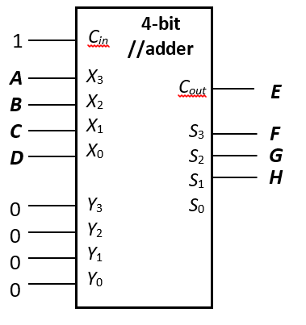
Q2 Block Circuit Design
EFGH = (ABCD + 1) / 2
Get the Carry-Out and 3 MSBs
Note: All input needs to be filled.
Notes:
Can I shift 1 from cin to y0?

Slide 13
Q2 Block Circuit Design
A | B | C | D | E | F | G | H
0 | 0 | 0 | 0 | 0 | 0 | 0 | 0
0 | 0 | 0 | 1 | 0 | 0 | 0 | 1
0 | 0 | 1 | 0 | 0 | 0 | 0 | 1
0 | 0 | 1 | 1 | 0 | 0 | 1 | 0
0 | 1 | 0 | 0 | 0 | 0 | 1 | 0
0 | 1 | 0 | 1 | 0 | 0 | 1 | 1
0 | 1 | 1 | 0 | 0 | 0 | 1 | 1
0 | 1 | 1 | 1 | 0 | 1 | 0 | 0
1 | 0 | 0 | 0 | 0 | 1 | 0 | 0
1 | 0 | 0 | 1 | 0 | 1 | 0 | 1
1 | 0 | 1 | 0 | 0 | 1 | 0 | 1
1 | 0 | 1 | 1 | 0 | 1 | 1 | 0
1 | 1 | 0 | 0 | 0 | 1 | 1 | 0
1 | 1 | 0 | 1 | 0 | 1 | 1 | 1
1 | 1 | 1 | 0 | 0 | 1 | 1 | 1
1 | 1 | 1 | 1 | 1 | 0 | 0 | 0
EFGH = (ABCD + 1) / 2

Slide 14
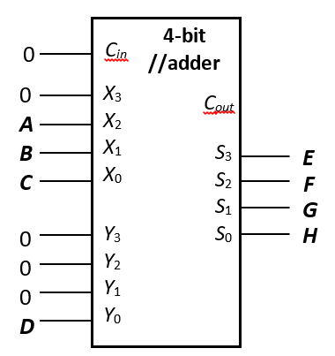
Q2 Block Circuit Design
EFGH = (ABCD + 1) / 2
If D = 0,
ABC1 / 2 = 0ABC = 0ABC + D
If D = 1,
(ABC1 + 1) / 2 = 0ABC + 1 = 0ABC + D
Note: All input needs to be filled.

Slide 15
Q2 Block Circuit Design
(b) 4221-to-8421
Input: PQRS
Output: WXYZ
Objective: Convert PQRS from 4221-to-8421, and store it in WXYZ
Component: Add-1-Then-Half Device

Slide 16
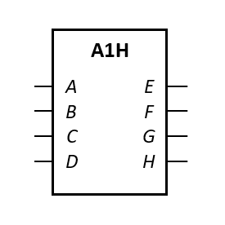
Q2 Block Circuit Design
4221-to-8421
P | Q | R | S | W | X | Y | Z
0 | 0 | 0 | 0 | 0 | 0 | 0 | 0
0 | 0 | 0 | 1 | 0 | 0 | 0 | 1
0 | 0 | 1 | 0 | 0 | 0 | 1 | 0
0 | 0 | 1 | 1 | 0 | 0 | 1 | 1
0 | 1 | 1 | 0 | 0 | 1 | 0 | 0
1 | 0 | 0 | 1 | 0 | 1 | 0 | 1
1 | 1 | 0 | 0 | 0 | 1 | 1 | 0
1 | 1 | 0 | 1 | 0 | 1 | 1 | 1
1 | 1 | 1 | 0 | 1 | 0 | 0 | 0
1 | 1 | 1 | 1 | 1 | 0 | 0 | 1
Notes:
4221 and 8421 are weights at each digit
8421 is also binary coded decimal BCD

Slide 17

Q2 Block Circuit Design
4221-to-8421
P | Q | R | S | W | X | Y | Z
0 | 0 | 0 | 0 | 0 | 0 | 0 | 0
0 | 0 | 0 | 1 | 0 | 0 | 0 | 1
0 | 0 | 1 | 0 | 0 | 0 | 1 | 0
0 | 0 | 1 | 1 | 0 | 0 | 1 | 1
0 | 1 | 1 | 0 | 0 | 1 | 0 | 0
1 | 0 | 0 | 1 | 0 | 1 | 0 | 1
1 | 1 | 0 | 0 | 0 | 1 | 1 | 0
1 | 1 | 0 | 1 | 0 | 1 | 1 | 1
1 | 1 | 1 | 0 | 1 | 0 | 0 | 0
1 | 1 | 1 | 1 | 1 | 0 | 0 | 1
Notes:
Whether the number is odd or even purely depends on the least significant digit

Slide 18
Q2 Block Circuit Design
4221-to-8421
WXY = (PQR + 1) / 2
P | Q | R | S | W | X | Y | Z
0 | 0 | 0 | 0 | 0 | 0 | 0 | 0
0 | 0 | 0 | 1 | 0 | 0 | 0 | 1
0 | 0 | 1 | 0 | 0 | 0 | 1 | 0
0 | 0 | 1 | 1 | 0 | 0 | 1 | 1
0 | 1 | 1 | 0 | 0 | 1 | 0 | 0
1 | 0 | 0 | 1 | 0 | 1 | 0 | 1
1 | 1 | 0 | 0 | 0 | 1 | 1 | 0
1 | 1 | 0 | 1 | 0 | 1 | 1 | 1
1 | 1 | 1 | 0 | 1 | 0 | 0 | 0
1 | 1 | 1 | 1 | 1 | 0 | 0 | 1

Slide 19
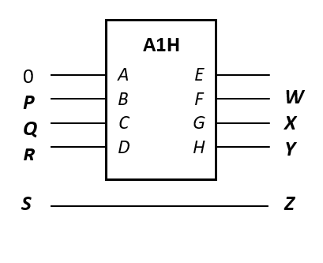
Q2 Block Circuit Design
4221-to-8421
WXY = (PQR + 1) / 2
P | Q | R | S | W | X | Y | Z
0 | 0 | 0 | 0 | 0 | 0 | 0 | 0
0 | 0 | 0 | 1 | 0 | 0 | 0 | 1
0 | 0 | 1 | 0 | 0 | 0 | 1 | 0
0 | 0 | 1 | 1 | 0 | 0 | 1 | 1
0 | 1 | 1 | 0 | 0 | 1 | 0 | 0
1 | 0 | 0 | 1 | 0 | 1 | 0 | 1
1 | 1 | 0 | 0 | 0 | 1 | 1 | 0
1 | 1 | 0 | 1 | 0 | 1 | 1 | 1
1 | 1 | 1 | 0 | 1 | 0 | 0 | 0
1 | 1 | 1 | 1 | 1 | 0 | 0 | 1
Notes:
PQR0 to WXY is wrong, but PQR1 to WXY is correct

Slide 20
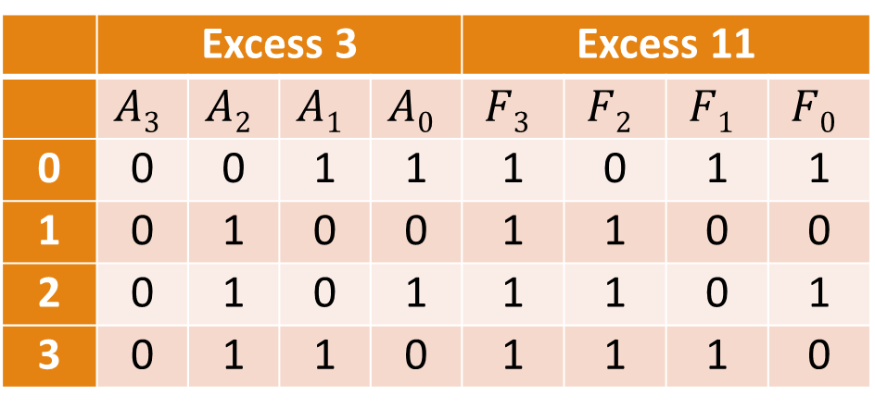
Q3
How do you implement a circuit that takes in a quaternary (base 4) digit A represented in 4-bit excess 3 code A₃A₂A₁A₀, and generates F₃F₂F₁F₀ which is A in excess 11 (eleven) code, without any logic gates?
 | Excess 3 |  |  |  | Excess 11
 | $$A3$$ | $$A2$$ | $$A1$$ | $$A0$$ | $$F3$$ | $$F2$$ | $$F1$$ | $$F0$$
0 | 0 | 0 | 1 | 1 | 1 | 0 | 1 | 1
1 | 0 | 1 | 0 | 0 | 1 | 1 | 0 | 0
2 | 0 | 1 | 0 | 1 | 1 | 1 | 0 | 1
3 | 0 | 1 | 1 | 0 | 1 | 1 | 1 | 0
Remember: Logic constants 0 and 1 are always available.
F₃F₂F₁F₀ =
1A₂A₁A₀
20
Notes:
Given a digit A, its excess 3 code is A+3, and its excess 11 code is A +11

Slide 21
Q4
Digits: | 0 | 1 | 2 | 3 | 4 | 5 | 6 | 7 | 8 | 9
Code: | 0000 | 0001 | 0010 | 0011 | 0100 | 0101 | 0110 | 0111 | 1000 | 1001
BCD code
Given two decimal digits A and B, represented by their BCD codes A₃A₂A₁A₀ and B₃B₂B₁B₀ respectively, implement a circuit without using any logic gates to calculate the BCD code of the 3-digit output of (51×A) + (20×(B%2)), where % is the modulo operator. Name the outputs F₁₁F₁₀F₉F₈ F₇F₆F₅F₄ F₃F₂F₁F₀.
A |  |  |  | 5×A
A₃ | A₂ | A₁ | A₀
Hint: Fill in the table on the right.
21

Slide 22
Q4
Digits: | 0 | 1 | 2 | 3 | 4 | 5 | 6 | 7 | 8 | 9
Code: | 0000 | 0001 | 0010 | 0011 | 0100 | 0101 | 0110 | 0111 | 1000 | 1001
BCD code
A |  |  |  | 5×A
A₃ | A₂ | A₁ | A₀
0 | 0 | 0 | 0 | 0 | 0 | 0 | 0 | 0 | 0 | 0 | 0
0 | 0 | 0 | 1 | 0 | 0 | 0 | 0 | 0 | 1 | 0 | 1
0 | 0 | 1 | 0 | 0 | 0 | 0 | 1 | 0 | 0 | 0 | 0
0 | 0 | 1 | 1 | 0 | 0 | 0 | 1 | 0 | 1 | 0 | 1
0 | 1 | 0 | 0 | 0 | 0 | 1 | 0 | 0 | 0 | 0 | 0
0 | 1 | 0 | 1 | 0 | 0 | 1 | 0 | 0 | 1 | 0 | 1
0 | 1 | 1 | 0 | 0 | 0 | 1 | 1 | 0 | 0 | 0 | 0
0 | 1 | 1 | 1 | 0 | 0 | 1 | 1 | 0 | 1 | 0 | 1
1 | 0 | 0 | 0 | 0 | 1 | 0 | 0 | 0 | 0 | 0 | 0
1 | 0 | 0 | 1 | 0 | 1 | 0 | 0 | 0 | 1 | 0 | 1
5×A = (10×A) / 2
22

Slide 23
Q4
Digits: | 0 | 1 | 2 | 3 | 4 | 5 | 6 | 7 | 8 | 9
Code: | 0000 | 0001 | 0010 | 0011 | 0100 | 0101 | 0110 | 0111 | 1000 | 1001
BCD code
A₃
A₂
A₁
A₀
A |  |  |  | 5×A
A₃ | A₂ | A₁ | A₀
0 | 0 | 0 | 0 | 0 | 0 | 0 | 0 | 0 | 0 | 0 | 0
0 | 0 | 0 | 1 | 0 | 0 | 0 | 0 | 0 | 1 | 0 | 1
0 | 0 | 1 | 0 | 0 | 0 | 0 | 1 | 0 | 0 | 0 | 0
0 | 0 | 1 | 1 | 0 | 0 | 0 | 1 | 0 | 1 | 0 | 1
0 | 1 | 0 | 0 | 0 | 0 | 1 | 0 | 0 | 0 | 0 | 0
0 | 1 | 0 | 1 | 0 | 0 | 1 | 0 | 0 | 1 | 0 | 1
0 | 1 | 1 | 0 | 0 | 0 | 1 | 1 | 0 | 0 | 0 | 0
0 | 1 | 1 | 1 | 0 | 0 | 1 | 1 | 0 | 1 | 0 | 1
1 | 0 | 0 | 0 | 0 | 1 | 0 | 0 | 0 | 0 | 0 | 0
1 | 0 | 0 | 1 | 0 | 1 | 0 | 0 | 0 | 1 | 0 | 1
0
0
A₀
0
A₀
0
A₃
A₂
A₁
23

Slide 24
Q4
5×A
50×A
51×A
A₃
A₂
A₁
A₀
0
0
0
0
0
0
A₀
0
A₀
0
A₃
A₂
A₁
24

Slide 25
Q4
5×A
50×A
51×A
51×A + (20×(B%2))
A₃
A₂
A₁
A₀
0
A₃
A₂
A₁
A₀
0
A₀
0
A₀
0
A₃
A₂
A₁
25
Notes:
B % 2: we just look at its LSB

Slide 26
Q4
5×A
50×A
51×A
51×A + (20×(B%2))
A₃
A₂
A₁
A₀
B₃
B₂
B₁
B₀
0
A₃
A₂
A₁
A₀
0
A₀
0
A₀
B₀
0
A₃
A₂
A₁
26

Slide 27
8. Magnitude Comparator (2/4)
Note:
x_{i} = 1 only when A_{i} = B_{i}
Let A = A₃A₂A₁A₀ , B = B₃B₂B₁B₀; x_{i} = A_{i}∙B_{i} + A_{i}'∙B_{i}'
A₃
x₃
A₃'∙B₃
B₃
A₃∙B₃'
A₂
A₃'∙B₃ + x₃∙A₂'∙B₂
+ x₃∙x₂.A₁'∙B₁
+ x₃∙x₂∙x₁∙A₀'∙B₀
x₂
B₂
(A < B)
A₁
x₁
B₁
A₃∙B₃' + x₃∙A₂∙B₂'
+ x₃∙x₂∙A₁∙B₁'
+ x₃∙x₂∙x₁∙A₀∙B₀'
A₀
x₀
(A > B)
B₀
(A = B)
x₃∙x₂∙x₁∙x₀


Slide 28
8. Magnitude Comparator (4/4)
A function F accepts a 4-bit binary value ABCD, and returns 1 if 3 ≤ ABCD ≤ 12, or 0 otherwise. How would you implement F using magnitude comparators and a suitable logic gate?
A
B
C
D
A₃
A₂
A₁
A₀
A₃
A₂
A₁
A₀
4-bit Comp
4-bit Comp
0
0
1
0
B₃
B₂
B₁
B₀
B₃
B₂
B₁
B₀
(A < B)
(A < B)
(A > B)
(A > B)
(A = B)
(A = B)
A₃
A₂
A₁
A₀
A₃
A₂
A₁
A₀
4-bit Comp
4-bit Comp
F
1
1
0
1
B₃
B₂
B₁
B₀
B₃
B₂
B₁
B₀
(A < B)
(A < B)
(A > B)
(A > B)
ABCD > 2 and ABCD < 13
(A = B)
(A = B)


Slide 29
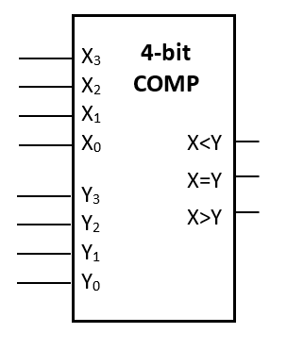

Q5 Magnitude Comparator
(a) F(A, B, C, D) = $\sum{m}\left(12−15\right)$

Slide 30
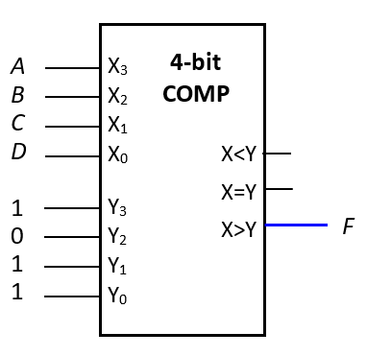

Q5 Magnitude Comparator
(a) F(A, B, C, D) = $\sum{m}\left(12−15\right)$
m12: A.B.C’.D’
m13: A.B.C’.D
m14: A.B.C.D’
m15: A.B.C.D
ABCD > 11

Slide 31

Q5 Magnitude Comparator
(a) F(A, B, C, D) = $\sum{m}\left(12−15\right)$
= A ∙ B
When A = B = 1, F = 1; Otherwise F = 0

Slide 32

Q5 Magnitude Comparator
(a) F(A, B, C, D) = $\sum{m}\left(12−15\right)$
= A ∙ B
When A = B = 1, F = 1; Otherwise F = 0
ABCD >= 1100 > 1011

Slide 33

Q5 Magnitude Comparator
A | B | C | D | G
0 | 0 | 0 | 0 | 1
0 | 0 | 0 | 1 | 0
0 | 0 | 1 | 0 | 0
0 | 0 | 1 | 1 | 0
0 | 1 | 0 | 0 | 0
0 | 1 | 0 | 1 | 0
0 | 1 | 1 | 0 | 1
0 | 1 | 1 | 1 | 0
1 | 0 | 0 | 0 | 0
1 | 0 | 0 | 1 | 1
1 | 0 | 1 | 0 | 0
1 | 0 | 1 | 1 | 0
1 | 1 | 0 | 0 | 0
1 | 1 | 0 | 1 | 0
1 | 1 | 1 | 0 | 0
1 | 1 | 1 | 1 | 1
(b) G(A, B, C, D) = $\sum{m}\left(0, 6, 9, 15\right)$
Palindromes

Slide 34
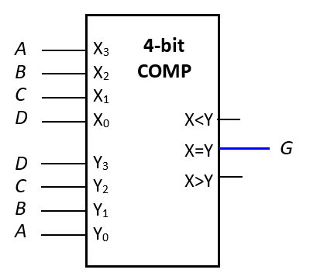
Q5 Magnitude Comparator
(b) G(A, B, C, D) = $\sum{m}\left(0, 6, 9, 15\right)$
Palindromes

Slide 35

Q5 Magnitude Comparator
A | B | C | D | H
0 | 0 | 0 | 0 | 1
0 | 0 | 0 | 1 | 1
0 | 0 | 1 | 0 | 0
0 | 0 | 1 | 1 | 0
0 | 1 | 0 | 0 | 0
0 | 1 | 0 | 1 | 0
0 | 1 | 1 | 0 | 1
0 | 1 | 1 | 1 | 1
1 | 0 | 0 | 0 | 1
1 | 0 | 0 | 1 | 1
1 | 0 | 1 | 0 | 0
1 | 0 | 1 | 1 | 0
1 | 1 | 0 | 0 | 0
1 | 1 | 0 | 1 | 0
1 | 1 | 1 | 0 | 1
1 | 1 | 1 | 1 | 1
(c) H(A, B, C, D) = $\sum{m}\left(0, 1, 6, 7, 8, 9, 14, 15\right)$
B == C → H = 1

Slide 36
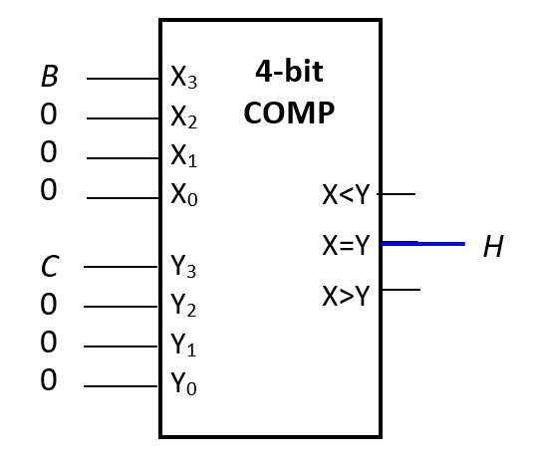
Q5 Magnitude Comparator
(c) H(A, B, C, D) = $\sum{m}\left(0, 1, 6, 7, 8, 9, 14, 15\right)$
B == C → H = 1
C
CD
AB
00 01 11 10
00
01
11
10
1
1
1
1
H = B.C + B’.C’
B
1
1
A
1
1
D

Slide 37

Q5 Magnitude Comparator
A | B | C | D | Z
0 | 0 | 0 | 0 | 0
0 | 0 | 0 | 1 | 1
0 | 0 | 1 | 0 | 0
0 | 0 | 1 | 1 | 1
0 | 1 | 0 | 0 | 0
0 | 1 | 0 | 1 | 1
0 | 1 | 1 | 0 | 0
0 | 1 | 1 | 1 | 1
1 | 0 | 0 | 0 | 0
1 | 0 | 0 | 1 | 1
1 | 0 | 1 | 0 | 0
1 | 0 | 1 | 1 | 1
1 | 1 | 0 | 0 | 0
1 | 1 | 0 | 1 | 1
1 | 1 | 1 | 0 | 0
1 | 1 | 1 | 1 | 0
(d) Z(A, B, C, D) = $\sum{m}\left(1, 3, 5, 7, 9, 11, 13\right)$
Easy if m15 is in Z
Find a way to include all with D = 1 except m15

Slide 38

Q5 Magnitude Comparator
A | B | C | D | Z
0 | 0 | 0 | 0 | 0
0 | 0 | 0 | 1 | 1
0 | 0 | 1 | 0 | 0
0 | 0 | 1 | 1 | 1
0 | 1 | 0 | 0 | 0
0 | 1 | 0 | 1 | 1
0 | 1 | 1 | 0 | 0
0 | 1 | 1 | 1 | 1
1 | 0 | 0 | 0 | 0
1 | 0 | 0 | 1 | 1
1 | 0 | 1 | 0 | 0
1 | 0 | 1 | 1 | 1
1 | 1 | 0 | 0 | 0
1 | 1 | 0 | 1 | 1
1 | 1 | 1 | 0 | 0
1 | 1 | 1 | 1 | 0
(d) Z(A, B, C, D) = $\sum{m}\left(1, 3, 5, 7, 9, 11, 13\right)$
Cin
4-bit
COMP
D
D
D
D
X₃
X₂
X₁
X₀
X<Y
X=Y
X>Y
A
B
C
D
Y₃
Y₂
Y₁
Y₀
Z

Slide 39
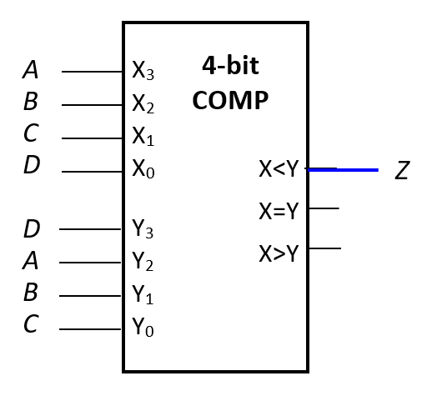
Q5 Magnitude Comparator
A | B | C | D | Z
0 | 0 | 0 | 0 | 0
0 | 0 | 0 | 1 | 1
0 | 0 | 1 | 0 | 0
0 | 0 | 1 | 1 | 1
0 | 1 | 0 | 0 | 0
0 | 1 | 0 | 1 | 1
0 | 1 | 1 | 0 | 0
0 | 1 | 1 | 1 | 1
1 | 0 | 0 | 0 | 0
1 | 0 | 0 | 1 | 1
1 | 0 | 1 | 0 | 0
1 | 0 | 1 | 1 | 1
1 | 1 | 0 | 0 | 0
1 | 1 | 0 | 1 | 1
1 | 1 | 1 | 0 | 0
1 | 1 | 1 | 1 | 0
(d) Z(A, B, C, D) = $\sum{m}\left(1, 3, 5, 7, 9, 11, 13\right)$
Notes:
When D=1, DABC equals to ABCD only when A=B=C=1. If we express ABCD and DABC in decimal, we get 8A+4B+2C+1 and 8+4A+2B+C. By equating them, we get 7 = 4A+2B+C, which is only valid when A, B and C are 1. In any other cases, ABCD < DABC i.e. X<Y.
When D = 0, DABC equals to ABCD only when A=B=C=0. In any other cases, ABCD > DABC i.e. X>Y.

Slide 40
9. Circuit Delays (2/5)
As a simple example, consider the full adder circuit where all inputs are available at time 0. Assume each gate has delay t.
X
Y
0
max(0,0)+t = t
max(t,0)+t = 2t
0
S
t
2t
max(t,2t)+t = 3t
C
Z
0
Outputs S and C experience delays of 2t and 3t respectively.

Slide 41
CS2100 Tutorial 7
Song Kai
song.kai@nus.edu.sg

